Slide 1
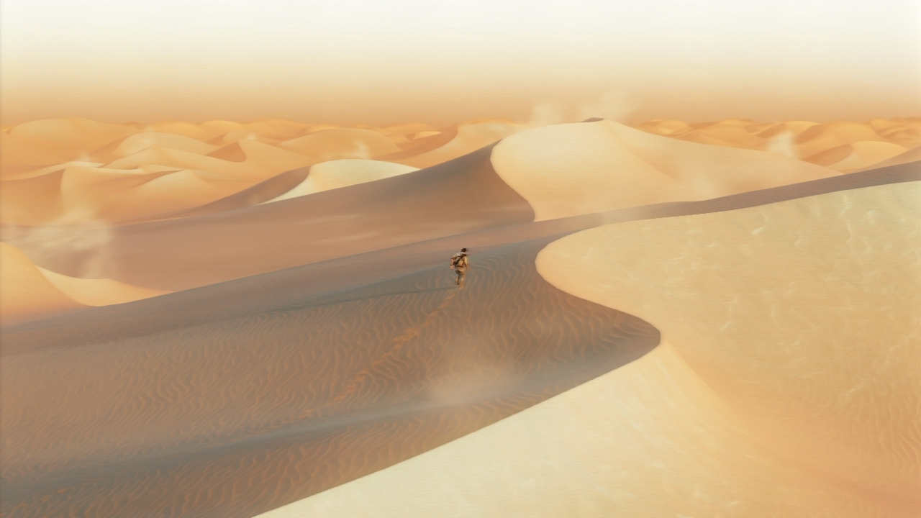
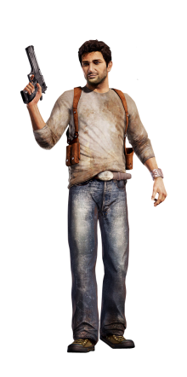

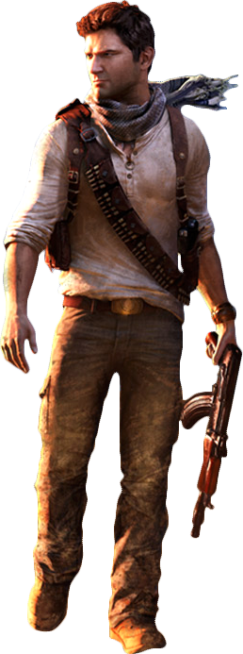
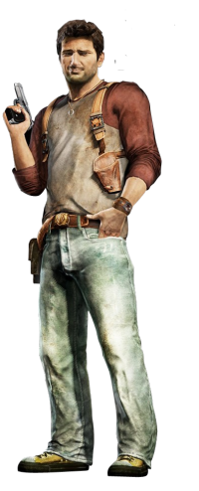
COPYRIGHT.NAUGHTY DOG & SONY COMPUTER ENTERTAINMENT
The story of the thRee ADVENTURES
COPYRIGHT.ANURAAG KALOJI.unchartedgamer

Slide 2
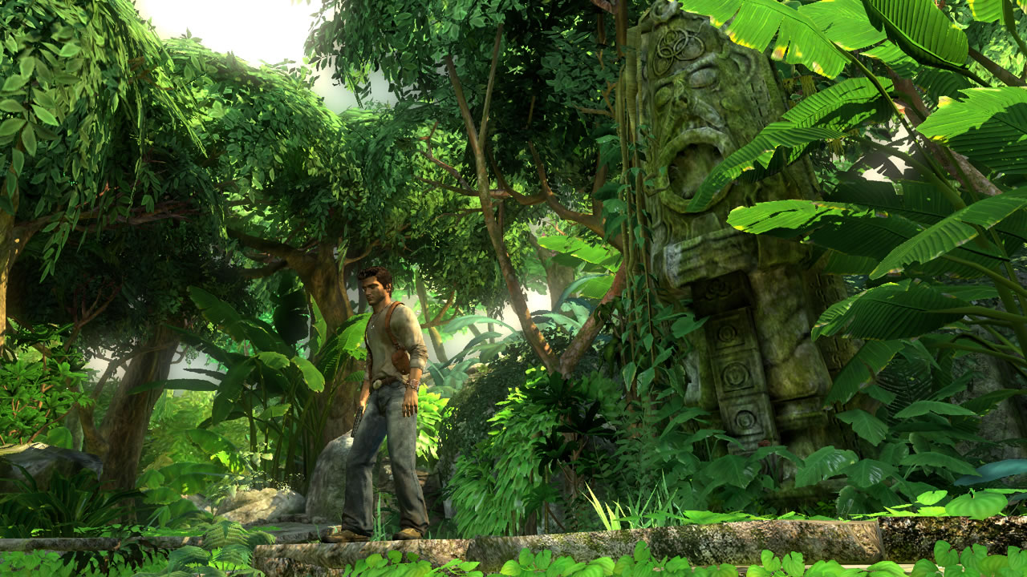
ADVENTURE ONE
UNCHARTED-DRAKE’S FORTUNE
A 400-year-old clue in the coffin of Sir Francis Drake sets Nathan Drake on an exploration for the fabled treasure of El Dorado, leading to the discovery of a forgotten island in the middle of the Pacific Ocean.
The search turns deadly when Drake becomes stranded on the island and hunted by mercenaries. Outnumbered and outgunned, Drake and his companions must fight to survive as they begin to unravel the terrible secrets hidden on the Island.

Slide 3
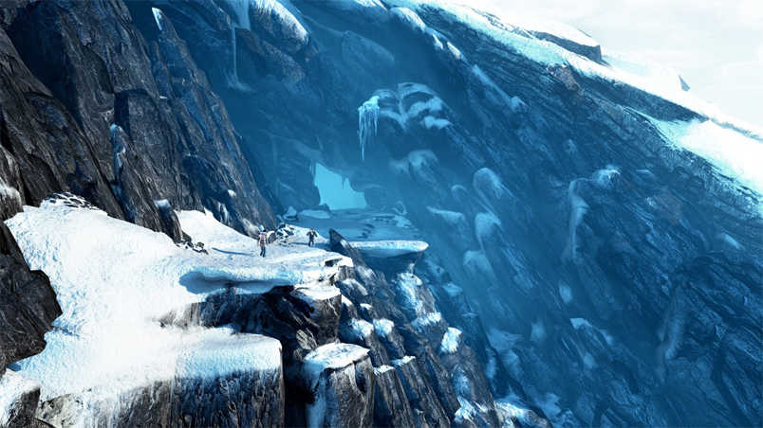
ADVENTURE TWO
UNCHARTED 2- AMONG THIEVES
Down on his luck, Drake is lured back into the treacherous world of thieves and mercenary treasure-seekers he had sought to leave behind. When a mysterious artifact propels Drake on an expedition to find the legendary Himalayan valley of Shambhala, he finds himself embroiled in a dangerous game of cat-and-mouse against a fugitive war criminal who’s after more than just the fabled riches of the lost city. Caught in a web of deception and plunged into an increasingly deadly pursuit that tests the limits of his endurance, Drake will be forced to risk everything – but has his luck finally run out?

Slide 4
ADVENTURE THREE
A search for the fabled “Atlantis of the Sands” propels fortune hunter Nathan Drake on a daring trek into the heart of the Arabian Desert, a journey that pits him and his mentor Victor Sullivan against the occult treachery of a shadowy clandestine organization and its ruthless leader. When the terrible secrets of this lost city are unearthed, Drake’s quest descends into a desperate bid for survival that strains the limits of his endurance and forces him to confront his deepest fears.
UNCHARTED 3
DRAKE’S DECEPTION

Slide 5
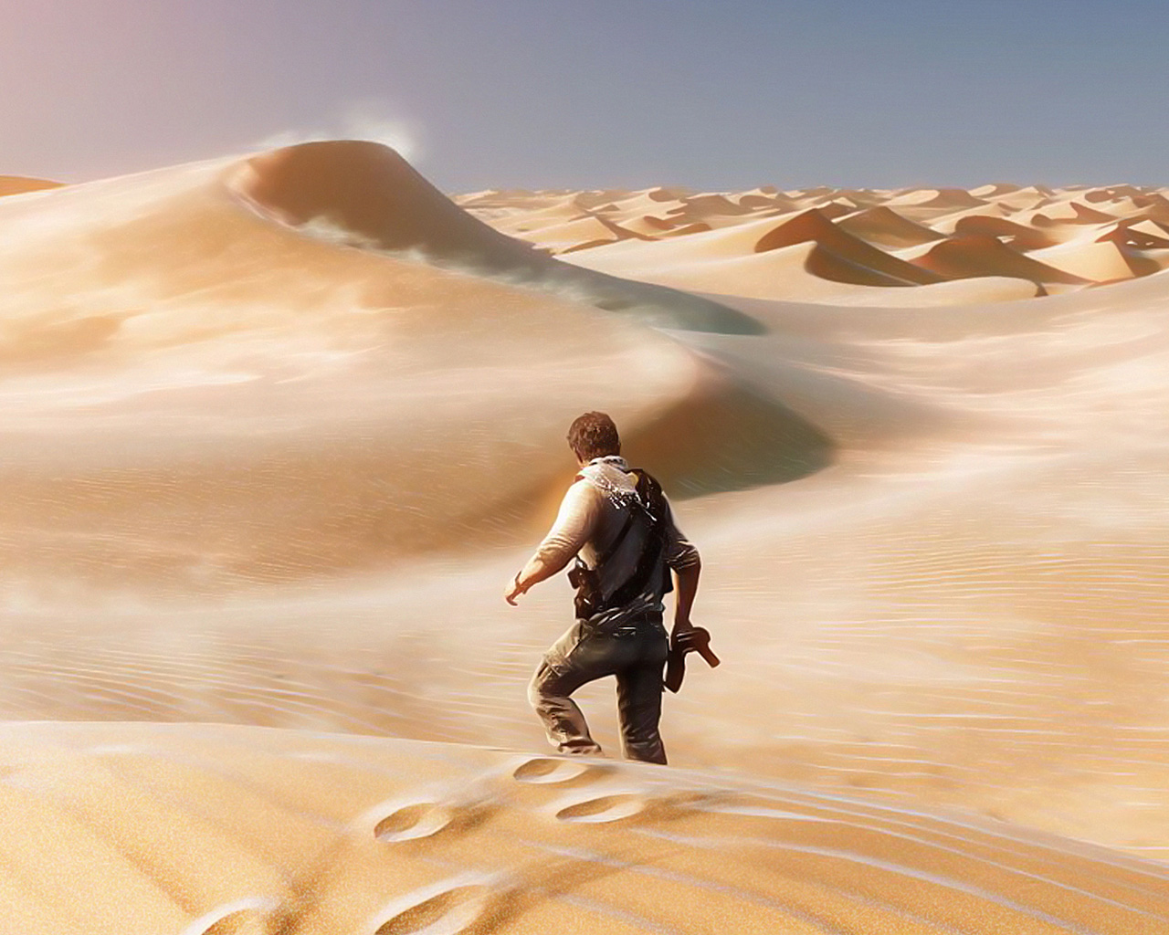
THE FINAL SECRET FOR ALL ADVENTURES
The Reason to all the adventures was that Nathan Drake wanted to know why Sir Francis Drake went on all those quests in the places in the previous two games & to find the secret of Sir Francis’ Ring.

